Slide 1
8 Generating Random Variates
Ref: Law & Kelton, Chapter 8
Updated Feb 2005

Slide 2
Overview
In our last set of lectures we learned about the process of generating a random number on the range (0-1].
In this week’s lectures we will learn about how we can turn a random number into a random variate.
The phrase “generating a random variate” refers to the process of obtaining an observation of a random variable from a desired distribution.
For example, let’s say we are simulating an arrival process with an exponential distribution (λ = 1). Using the techniques of chapter 7, we generate the random number 0.6. How do we turn these two pieces of information into a simulated inter-arrival time?

Slide 3
Overview (Continued)
Generally, all random variates require the use of a U(0,1) distribution.
The exact technique used to generate an observation varies with the type of distribution used. However, in general we’re looking for techniques that are:
    Exact
    Efficient in terms of time, storage, and setup
    Low in complexity
    Robust.

Slide 4
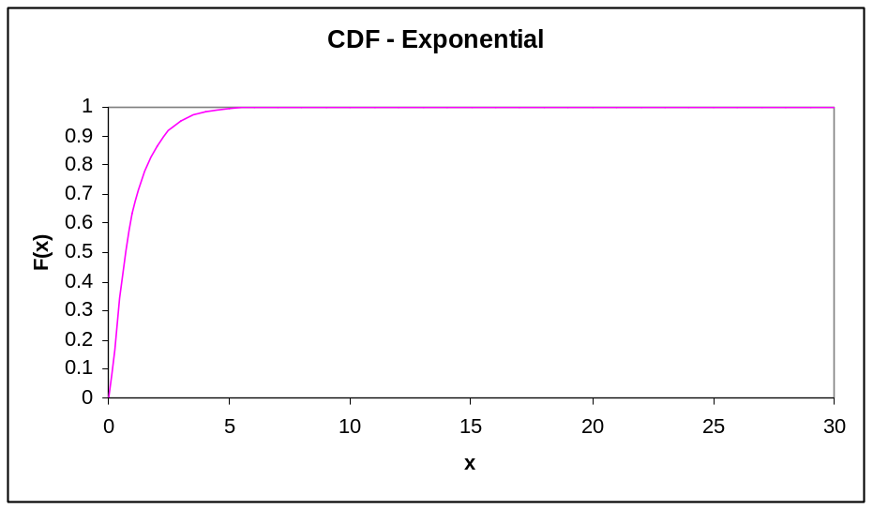
Inverse Transformation
On the right I have plotted the CDF for an exponential distribution with mean = 1.0.
Note that the CDF has a range [0,1].
If r = 0.6 is our “y” value on the CDF, the problem of generating a random variate is simply coming up with the corresponding “x” value.
By inspection, we can see that for r = 0.6, the value of x ~ .9

Slide 5
Inverse Transformation - Exponential
For tractable distributions (like an exponential) we can easily determine the inverse transformation analytically.
Recall that F(x) = 1- e^{-x/β} is the CDF for an exponential distribution.
Let r (our random number) be F(x).
r = 1- e^{-x/β} Solving for x:
(1-r) = e^{-x/β}
ln(1-r) =-x/β
-βln(1-r) = x
if β = 1 and r = 0.6, then x = -1ln(1-.6) = .916

Slide 6
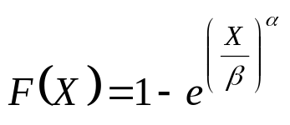
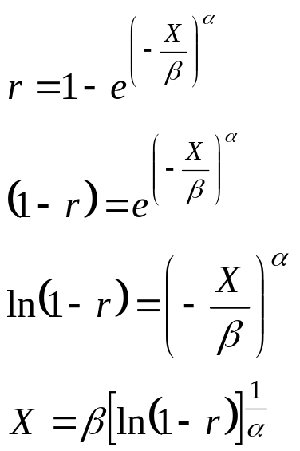
Inverse Transformation - Weibull
Recall the CDF of a Weibull is:
Letting r = F(X)

Slide 7
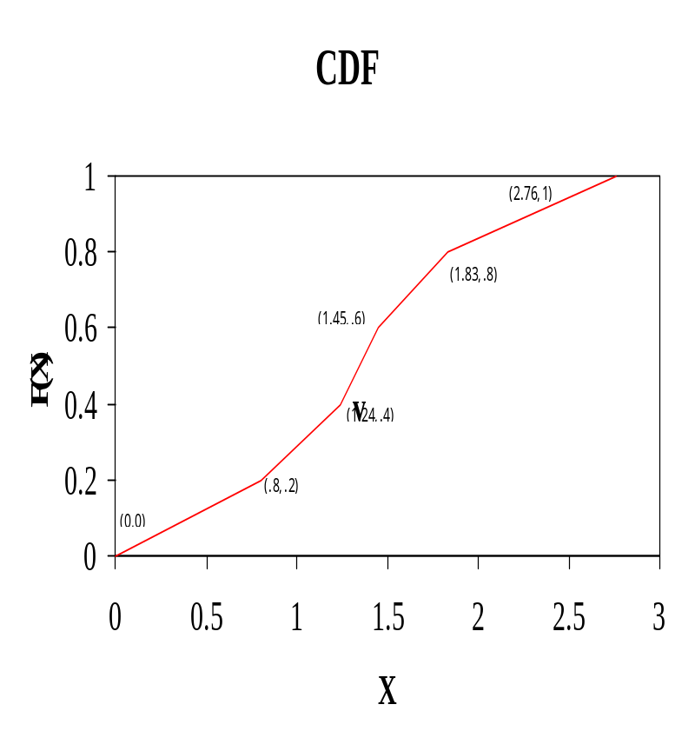
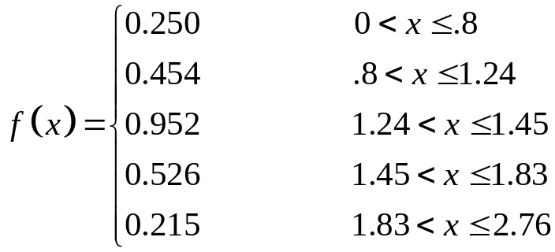
Inverse Transformation - Empirical
Consider the following continuous empircal pdf:
You might note that in the above example, each of the ranges has an equal probability (0.2).
The CDF for this function is given on the right.

Slide 8
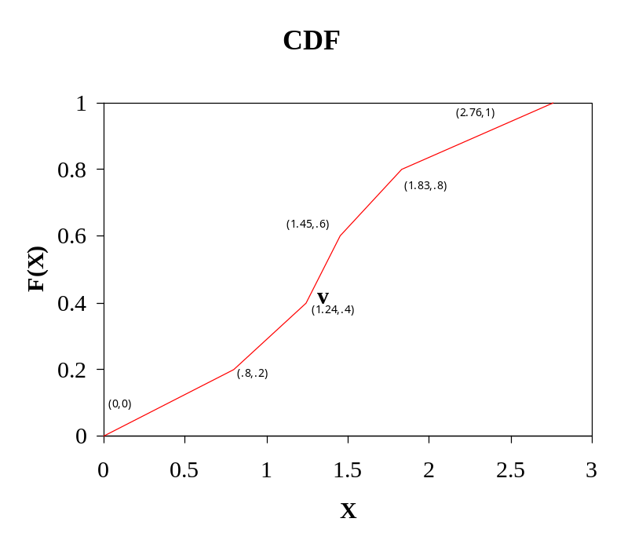
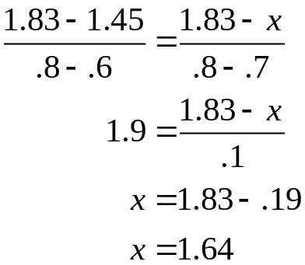
Inverse Transformation - Empirical
The inverse transformation method works well on continuous empirical functions.
For example let’s say we have selected r = 0.7. By eyeball we’d say this corresponds to X ~ 1.7
Of course, we can determine this value analytically.
r = .7 falls in the range bounded by (1.45, 0.6), (1.83, 0.8)
By linear interpolation our point will obviously be:

Slide 9
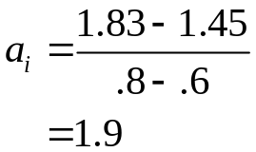
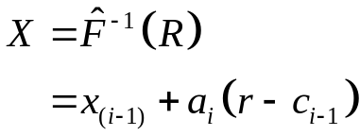
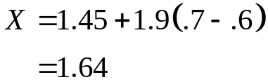
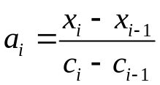
Inverse Transformation - Empirical
Formally, the formula for the inverse transformation of a continuous random distribution is:
Where x_{i} is the end of the i_{th} interval and c_{i} is the value of F(X) at x_{i.}

Slide 10
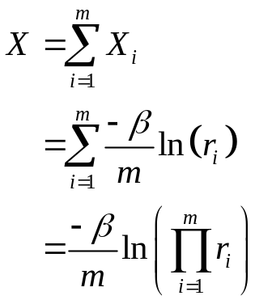
Convolution Technique - Erlang
For some intractable distributions, we can express the random variate as the sum of two or more random variates.
Recall that an Erlang distribution with parameters (m, β) can be expressed as the sum of K independent exponential random variables with mean β/m
Ex: m = 2; β = 1
Select two random numbers:
r₁ = .2; r₂ = .4
X = - 1/2ln(.2*.4) = 1.26
Thus to generate an Erlang rv, we
generate k random numbers ~U(0,1)
and use them to return X.

Slide 11
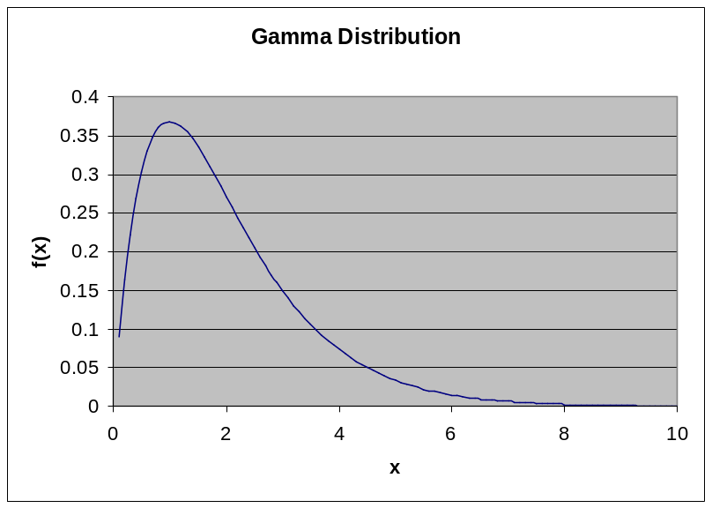
Acceptance – Rejection Technique
For other intractable distributions (like the gamma) we must use a slightly more involved process.
On the right is a gamma(.75,1) distribution.
A closed form for F(X) does not exist, so what we’ll do is add in another distribution for which we do know how to calculate the CDF and its inverse.
We pick a function t(x) that is larger than f(x) for all x. Technically we say that t(x) majorizes f(x).

Slide 12
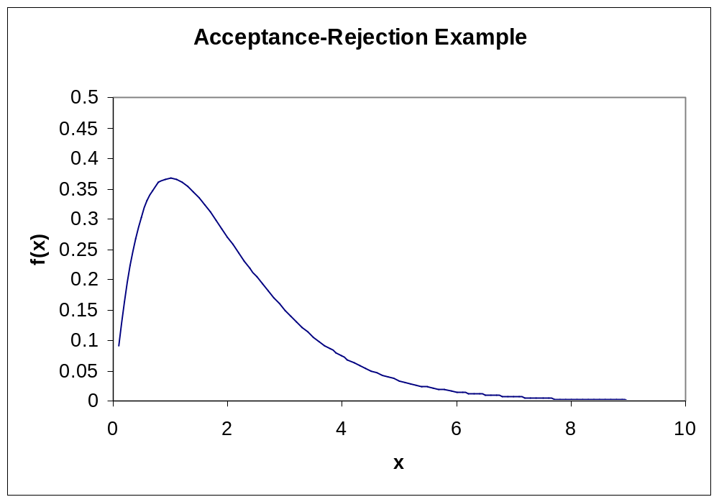
Acceptance – Rejection
t(x) = .4

Slide 13
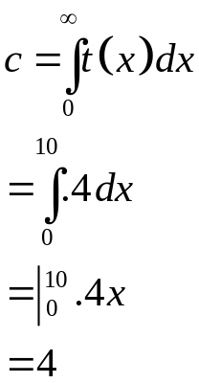
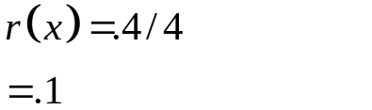
Acceptance-Rejection
In our example we selected t(x) = .4 0 <= x <= 10
Now t(x) doesn’t really fit the definition of a distribution, since its integral from 0 to 10 doesn’t add up to 1.
However let us define c: And r(x) = t(x)/c:

Slide 14
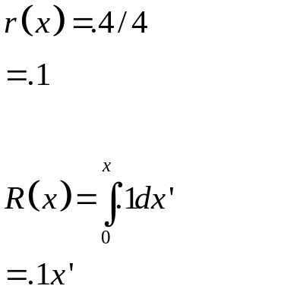
Acceptance-Rejection
Since we know the pdf of r, we can calculate the cdf:
And in this simple case, we can easily determine the inverse transformation for R: X = 10Y.
So, let’s say we pick a random number Y = .3.
This translates into an X of 3

Slide 15
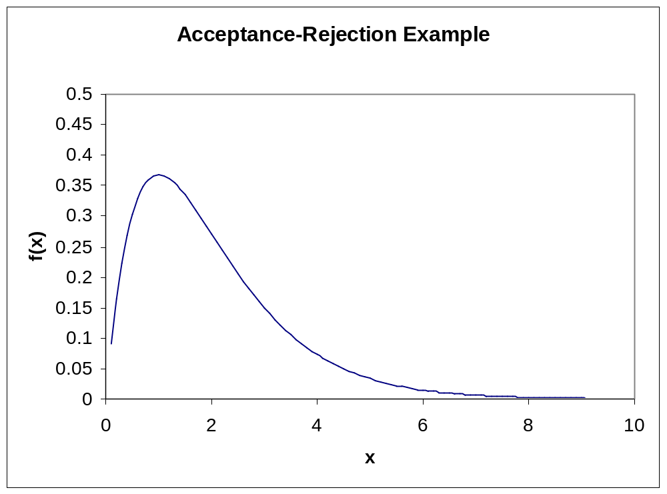
Acceptance – Rejection
t(x) = .4
If we threw darts that could land only on the line x = 3, then the probability that a dart hitting inside the distribution would be f(X=3)/t(X=3).*
*Note: I am using slightly different notation than in Law and Kelton

Slide 16
Acceptance – Rejection
t(x) = .4
f(X=.3)/t(X=.3)
= .15/.4
= .375
Draw U~U(0,1).
If U is less than .375, we will accept X= 3 as coming from a gamma(2,1) distribution.
Otherwise, we will start the process over by selecting a new R and new U.
*Note: I am using slightly different notation than in Law and Kelton

Slide 17
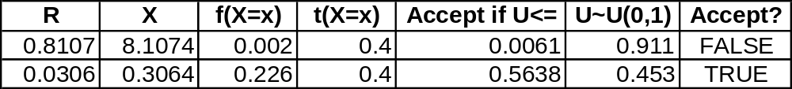
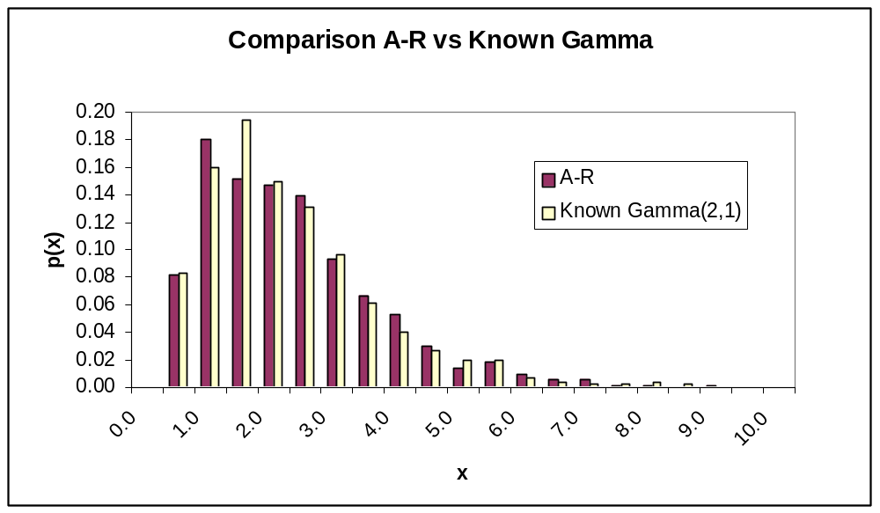
Acceptance – Rejection
For illustration, I have included the calculations for one call to the function to return a random variate for the gamma(2,1) distribution. In this example, the value .3064 would be returned.
For comparison, I’ve generated a histogram using the A-R technique and t(x) =.4 and compared it against a histogram from a known Gamma (2,1) distribution.
n = 1000 in this case. As you can see, the technique performs reasonably well.

Slide 18
Acceptance – Rejection (Continued)
Now, as you might imagine, the function t(x) = .4 isn’t a particularly great choice as a majorizing function.
Note that there are some wide gaps between t(x) and f(x).
This will impact the efficiency of our generation procedure, since we’ll end up throwing out a lot of generated values before we’ll accept one.

Slide 19
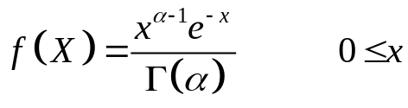
Acceptance – Rejection Gamma
We start out by noting that we can limit our discussion to cases of generating gamma (α, 1) since for any β > 0 a X’ =gamma (α, β) can be obtained from as βX, where X is generated from a gamma (α, 1).
Note: There are two cases for generating a gamma (α, 1), one in which α < 1 and the other were α > 1. The special case of α = 1 can be handled as an exponential distribution.
We will limit our discussion, for the sake of brevity, to α < 1.
Recall that if β=1 then the gamma distribution is:

Slide 20
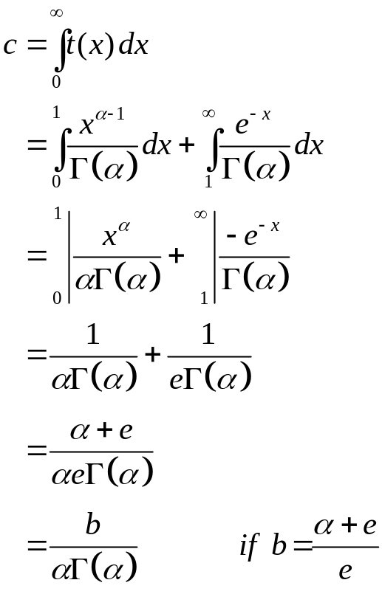
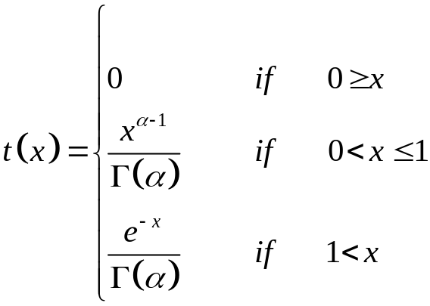
Acceptance – Rejection Gamma
We will select a majorizing function t(x):
c is thus:

Slide 21
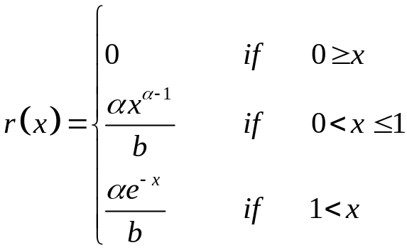
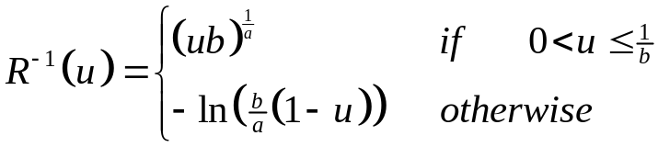
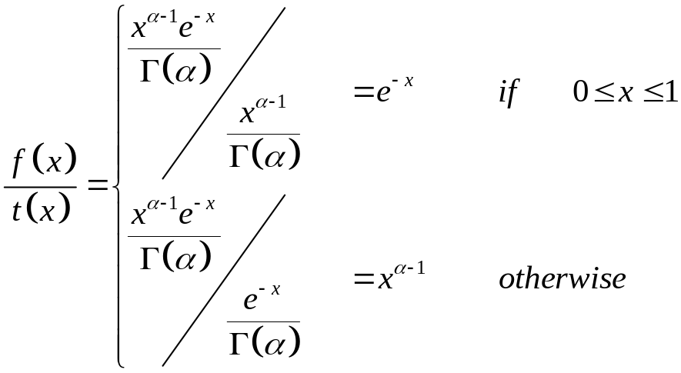
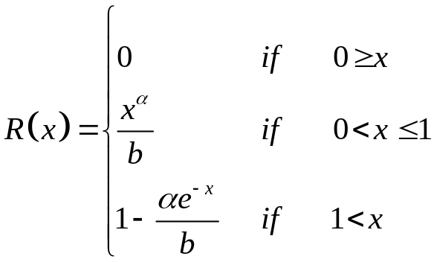
Acceptance – Rejection Gamma
Setting r(x) as t(x)/c we get:
Of course, it is relatively simple to calculate the inverse of R(x):
Finally, we need to calculate our acceptance criteria f(x)/t(x):
We can find the CDF of r(x) by integration:

Slide 22
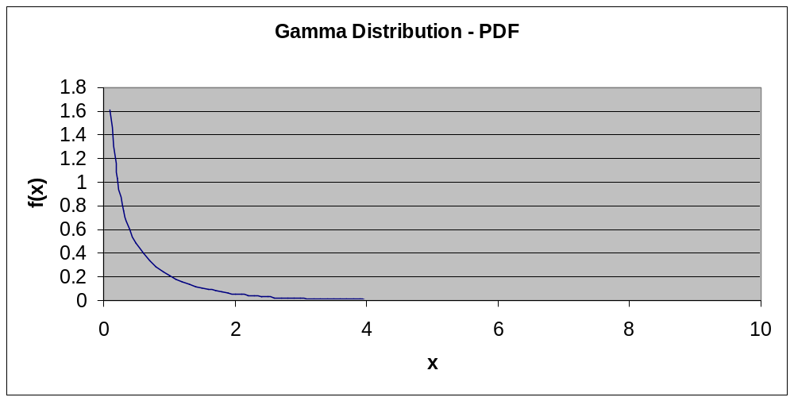
Gamma (0.5, 1) Example

Slide 23
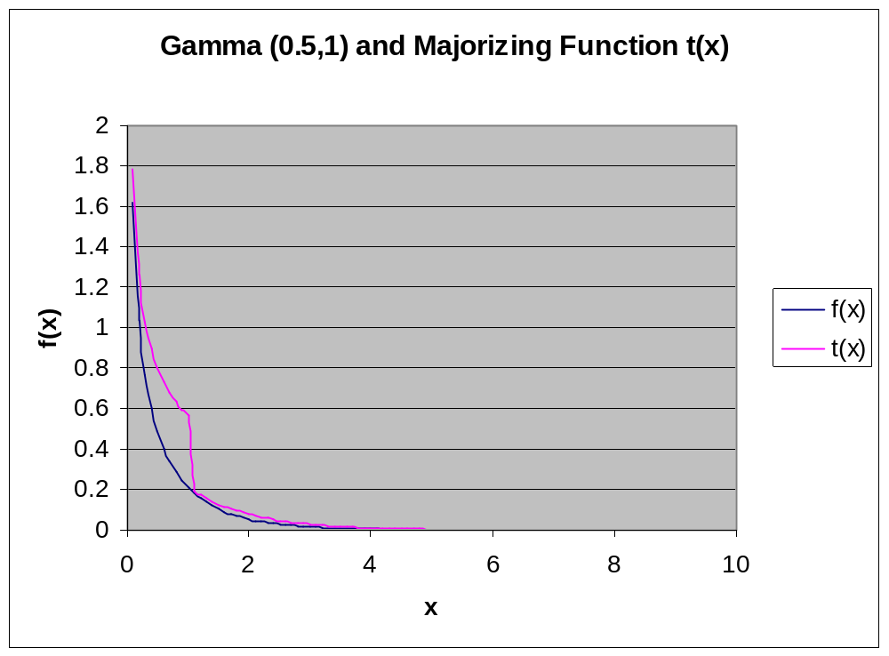
An Example with Gamma(.5,1)

Slide 24
Acceptance – Rejection Gamma
Start the algorithm by pre-calculating b:
    b = (e¹+α)/e¹
    = (e¹+.5)/e¹
    = 1.18
Select a U₁ = U(0,1). Use this value in R⁻¹(u) to determine a trial value of x.
    Suppose we picked the u₁ = 0.2, then since 0.2 < 1/b (.845) we have a trial x of
    (bu)^{1/ α} = (1.18*.2)^{1/.5} = .056
Test the trial value of x by calculating f(x)/t(x) and picking a new random number U₂ = U(0,1). Since our trial value of x is less than 1 our selection criteria is:
    f(x)/t(x) = e^{-x} = e^{-.056} = .945
    Assume we pick U₂ = .4
    Since U₂ = .4 < .945, we would accept this value.

Slide 25
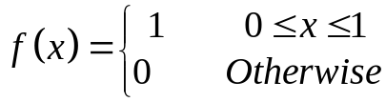
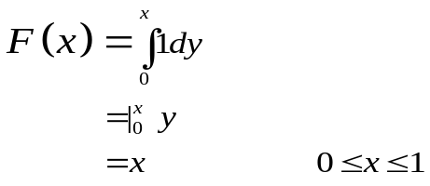
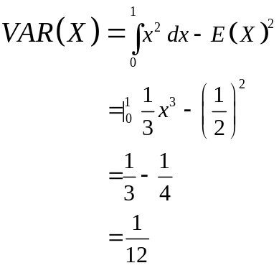
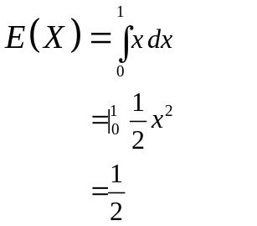
Uniform Continu U(0, 1)
f(x)
1
0
1
x

Slide 26
Properties of Random Numbers
Random numbers should be uniformly distributed and independent.
Uniformity: If we divide (0,1) into n equal intervals, then we expect the number of observations in each sub-interval to be N/n where N is the total number of observations.
Independence: The probability of observing a value in any sub-interval is not influenced by any previous value drawn.

Slide 27
Good Properties
Since we cannot generate “true” random numbers we want to generate a sequence of numbers with the following properties:
    Speed – the algorithm must be quick.
    Portable – easily moved between different hardware and software.
    Long cycle (period) – the sequence generated should repeat itself
    Repeatability – it must be possible to recreate the sequence of numbers (typically for different scenarios).
    Statistical properties – the generated numbers must be able to pass tests for uniformity and independence.

Slide 28


Linear Congruential Generators
Oddly enough, the mechanism for generating a random number stream is fairly simple.
We generate a stream of numbers [0,m)
mod is the modulo operator (i.e. 11 mod 3 = 2)
And we convert these to a number [0,1):

Slide 29
Example 1
X₀ = 27
a = 17
c = 43
m = 100
X_{i+1} = (aX_{i}+c) mod m
= (17X_{i}+43) mod 100
X₁ = (17*27 + 43) mod 100
= 502 mod 100
= 2
R₁ = X₁/m
= 2/100
= .02
X₂ = (17*2 + 43) mod 100
= 77 mod 100
= 77
R₂ = X₂/m
= 77/100
= .77

Slide 30


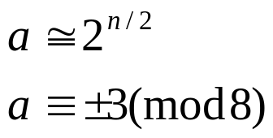
One such set of Rules

Slide 31
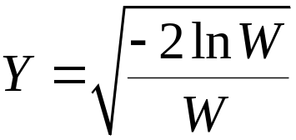
Generating Normal Variates
The following recipe (Marsaglia and Bray) generates pairs of random variates on N(0,1):
Generate U₁, U₂ as U(0,1).
Let V₁ = 2U₁ – 1
V₂ = 2U₂ – 1
W = V₁² + V₂²
If W > 1, then go back to 1 and try again.
Otherwise, let:
X₁ = YV₁ and X₂ = YV₂ are IID N(0,1) variates.

Slide 32
Normal Example
U₁ = 0.8, U₂ = 0.3
V₁ = 2(.8) – 1 = .6
V₂ = 2(.3) – 1 =-.4
W = .6² + (-.4)² = 0.52
W is <= 1, we can continue.
Y = (-2ln(.52)/(.52))^{.5} = 1.586
X₁ = 1.586(.6) = .952
X₂ = 1.586(-.4) = -.634

Slide 33
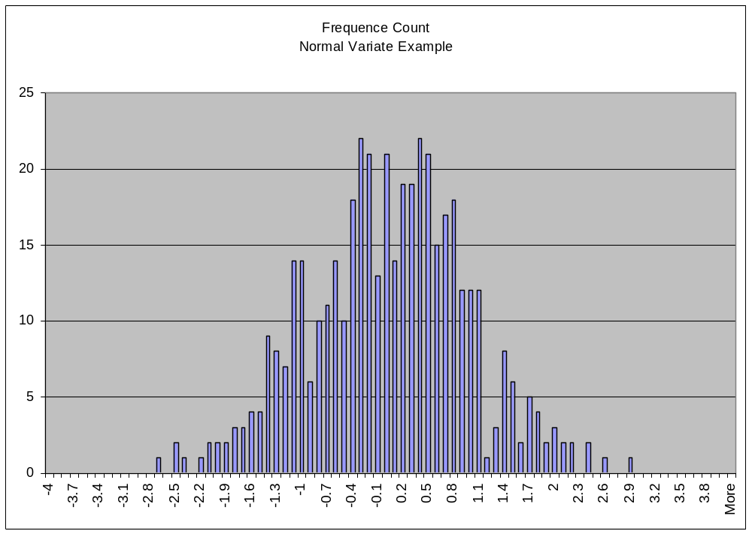
Normal Example – 300 Pairs

Slide 34
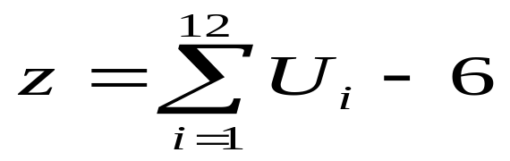
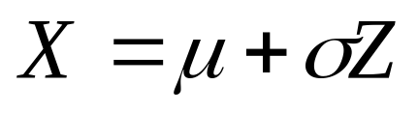
Alternative :
z → N (0 , 1)

Slide 35
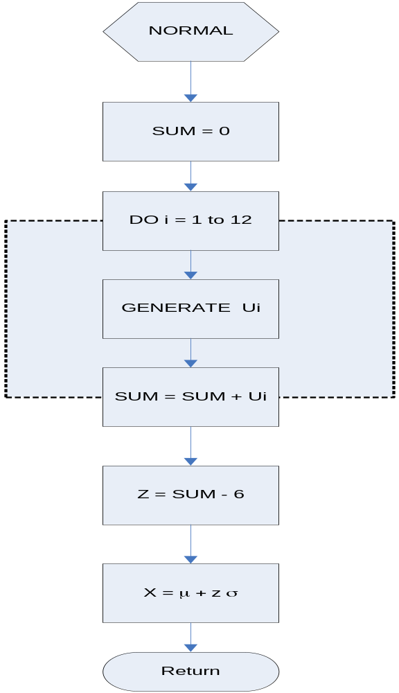

Slide 36
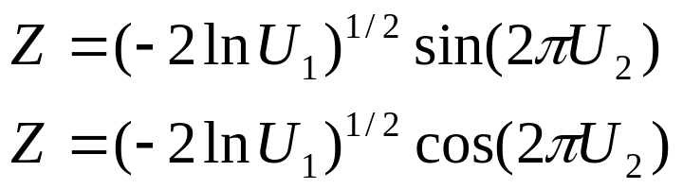
Alternative :
z → N (0 , 1)

Slide 37
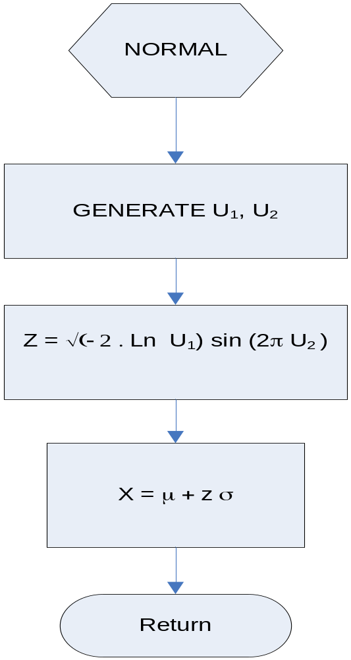

Slide 38
Normal Example – 300 Pairs

Slide 39
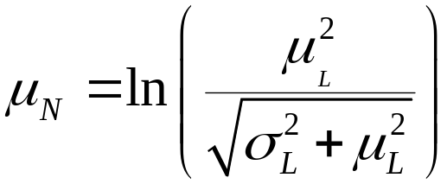
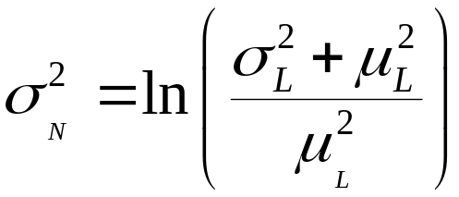
Generating Lognormal Variates
If Y~N(μ_{N}, σ_{N}) then e^{Y} ~ LN(μ_{N}, σ_{N})
Calculate μ_{N}, λ_{N} from μ_{L}, λ_{L}, the parameters of the lognormal distribution.
Generate Y~N(μ_{N}, σ_{N})
Return X = e^{Y}

Slide 40
Generating Beta Variates
If Y₁~gamma(α₁,1) and Y₂~gamma(α₂,1)
then Y₁/(Y₁ + Y₂) ~ beta(α₁,α₂)
Generate Y₁~gamma(α₁,1)
Generate Y₂~gamma(α₂,1)
Return X = Y₁/(Y₁ + Y₂)

Slide 41

Poisson Arrival Processes
Just a reminder about arrival processes:
If an arrival process is Poisson, then the time between arrivals, by definition, is exponentially distributed.
Thus, to simulate a Poisson arrival process, we use the exponential distribution for inter-arrival time and the following formula:
Where λ is the arrival rate (which must be greater than 0)
u is a uniformly distributed random number ~ U(0,1)
t_{i-1} is the arrival time of the i-1st job.

Slide 42
Non-Stationary Poisson Processes
L & K make point out that it is incorrect to simulate non-stationary Poisson processes by changing λ on the fly.
If a job arriving just prior to t₁ has a very long inter-arrival time, resulting in an arrival time greater than t₂, the “rush period” between t₁ and t₂ will be missed.
λ
t1
t2
t

Slide 43
Non-Stationary Poisson Processes
To correct this problem, L&K suggest a complex thinning algorithm based on acceptance-rejection techniques.
This is just plain silly.
The simpler way around this problem is to set separate create nodes in your simulation model for each distinct value of λ.
λ
t1
t2
t

Slide 44


Generating Other Discrete Variates
Discrete Uniform
  Generate U~U(0,1)
  Return X =
Arbitrary Discrete
  Generate U~U(0,1)
  Return X such that

Slide 45
Generating Other Discrete Variates
Bernoulli Trial (Bern(p))
  Generate U~U(0,1)
  If U <= p, return 1, otherwise return 0.
Binomial (bin(t,p))
  Generate Y₁, Y₂, …Y_{t} Bernoulli(p) variates
  Return X = Y₁+Y₂ + … +Y_{t}

